Slide 1
Shipment Sure AI : Predicting On-Time Delivery Using Supplier Data

Slide 2
Table of Content
Introduction
Motivation
Project Objective
Dataset Overview
Exploratory Data Analysis (EDA)
Feature Engineering
Model Development
Predicate Logic
System Architecture
Deployment & Results
Technical Feasibility
Conclusion
Future Scope

Slide 3
Introduction
E-commerce logistics is a key component of modern business operations.
Timely delivery is essential for maintaining customer satisfaction and operational efficiency.
Machine learning helps analyze historical data to predict delivery outcomes.
This project develops an AI-based system for delivery prediction.

Slide 4
Motivation
Delivery Delays Unexpected delays reduce customer satisfaction
Operational Inefficiency Poor logistics planning causes bottlenecks
No Prediction System Businesses react instead of predict
Business Loss Leads to SLA penalties and revenue loss

Slide 5
Project Objective
Delivery Prediction
Predict whether shipment is On-Time or Delayed
Risk Identification
Detect high-risk shipments early.
Decision Support
Enable proactive logistics decisions
Efficiency Improvement
Reduce delays and improve operations.

Slide 6
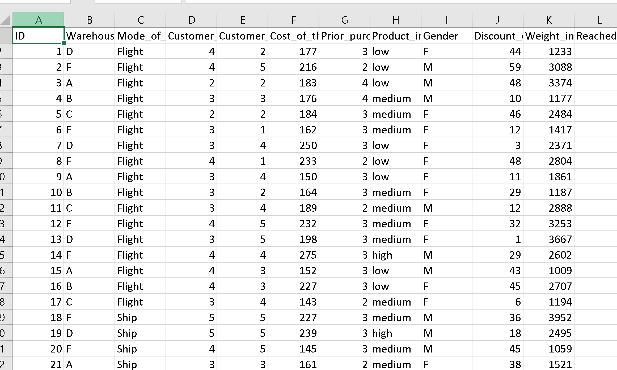
Dataset Overview
Dataset Source: E-Commerce Shipping & Supplier Data (Kaggle)
Dataset Size:
Total Rows: 10,999
Total Columns: 12
Key Features Include:
Warehouse Block (A-F)
Mode of Shipment (Flight, Ship, Road)
Product Importance (Low, Medium, High)
Discount Offered(%)
Customer Care Calls
Customer Rating (1-5)
Cost of Product
Weight of Shipment (in grams)

Slide 7
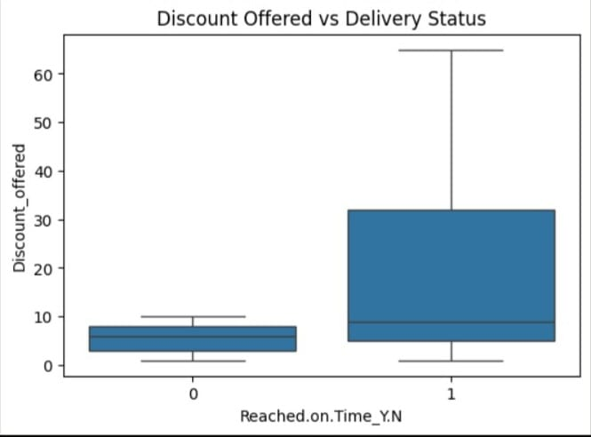
Exploratory Data Analysis (EDA)
Analyzed discount vs delivery status distribution
Observed low discounts in delayed shipments
Identified high discounts in on-time deliveries
Found clear threshold around 10% discount
Detected discount as a key factor affecting delivery

Slide 8
Model Development
Models Used: Logistic Regression, Random Forest, XGBoost
Final Model Selected: XGBoost
Reason: Better accuracy and Handles complex patterns

Slide 9
Prediction Logic
If Discount > 10% → On-Time
Else → Check Weight Check Customer Calls Check Rating
Multi-factor decision system

Slide 10
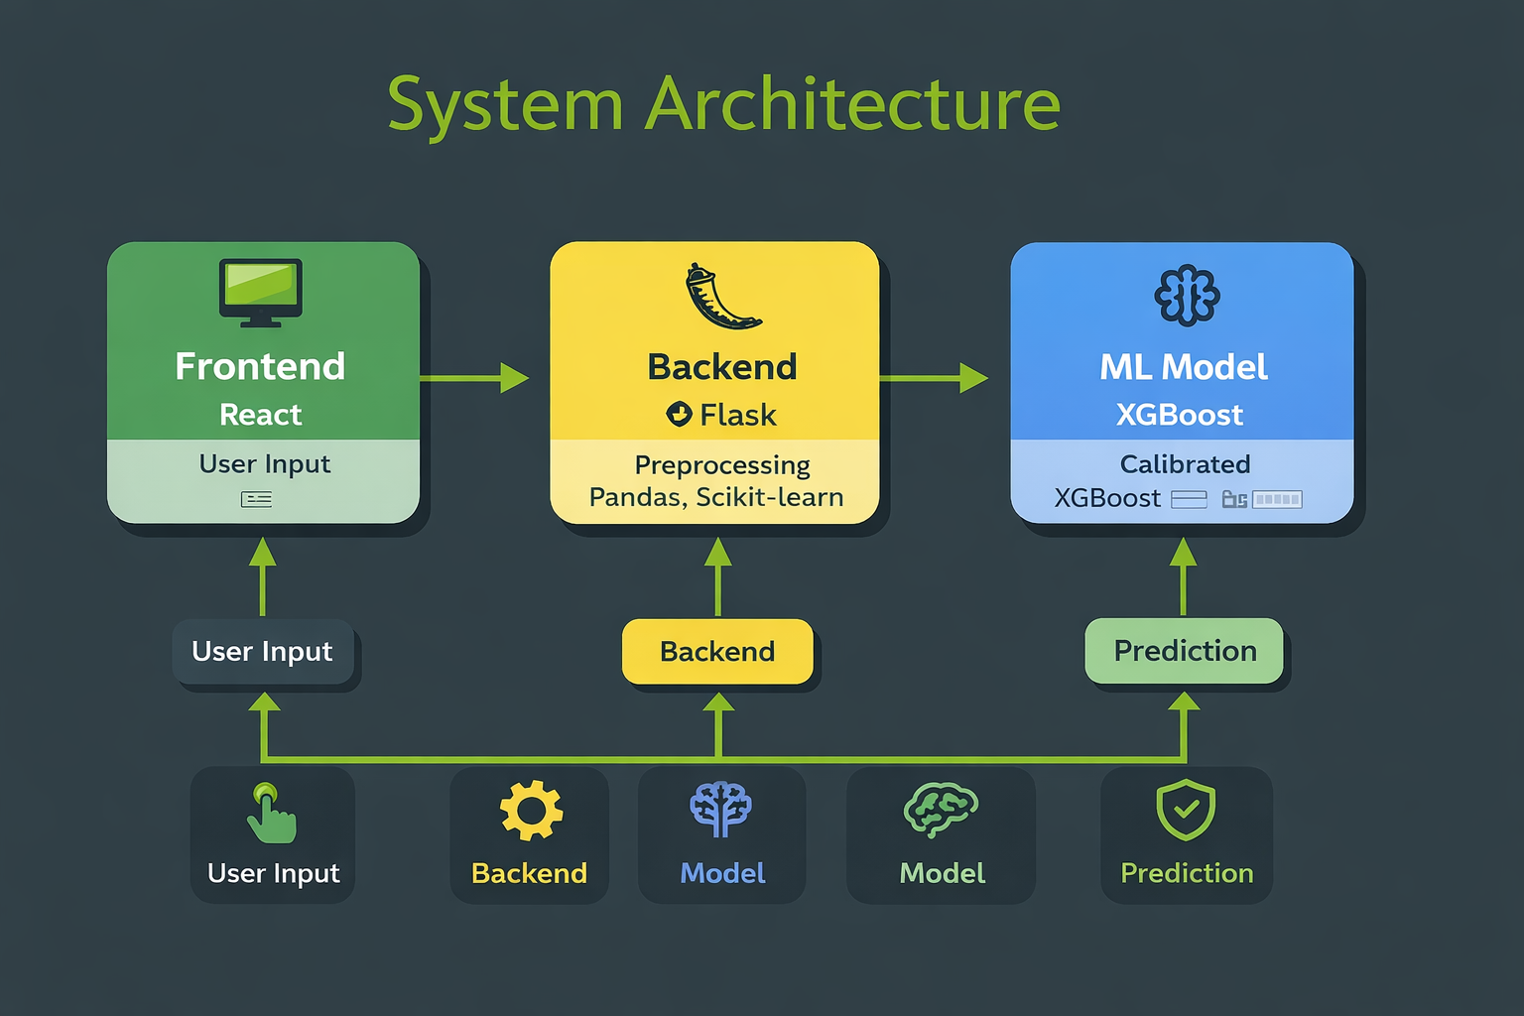
System Architecture
Frontend: React / Streamlit Backend: Flask Model: XGBoost
Preprocessing: Pandas, Scikit-learn
Deployment: Web-based application
Flow:
User Input → Backend → Model → Prediction

Slide 11
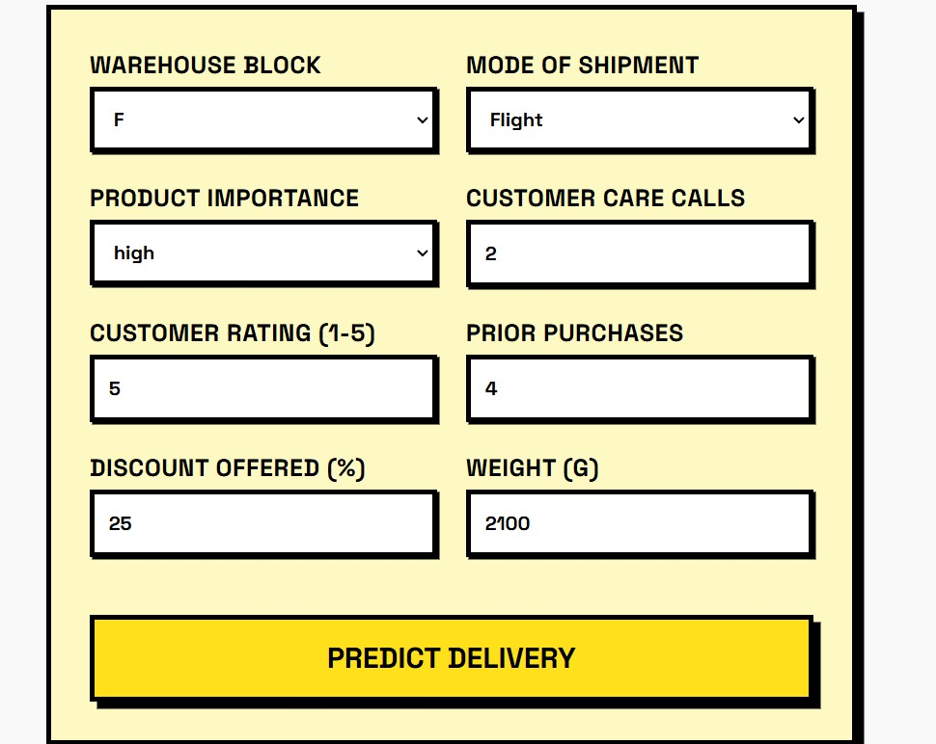
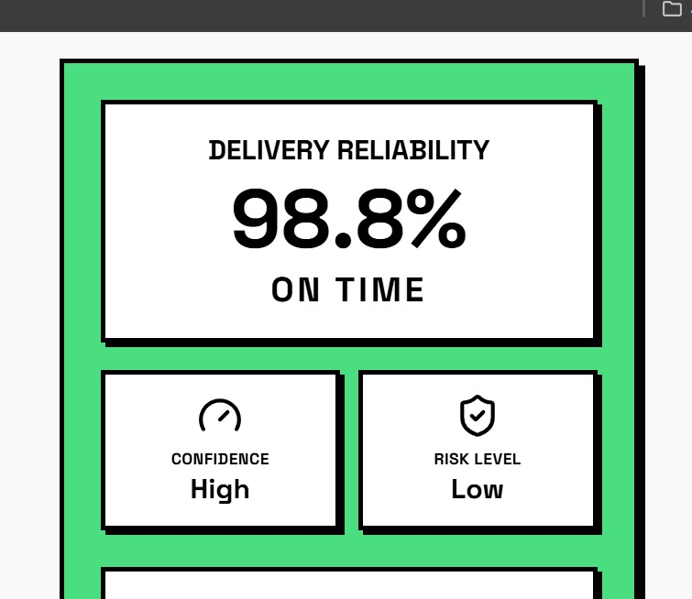
Deployment & Results
Real-time prediction system
Improved logistics decisions
Reduced delivery delays
Interactive user interface

Slide 12
Technical Feasibility
Low-cost implementation
Uses Python & ML libraries
Scalable and efficient system
Supports real-time integration

Slide 13
Conclusion
ML Model Deployed XGBoost with GridSearchCV
Full EDA Pipeline Analyzed 10,000+ records
Interactive Web App Real-time prediction system
End-to-End Workflow Data → Model → Deployment

Slide 14
Future Scope
Key Takeaways :
ML predicts delivery reliability effectively
Top factors: shipment mode, rating, importance
Feature engineering improved performance
Real-time insights for logistics teams
Future Scope :
Real-time API integration
Deep learning models (LSTM)
Multi-supplier analytics
ERP/CRM integration

Slide 15
Thank You

